Slide 1
Sam

Slide 2
PCB
Ordered controller board revision A
Ordered breakout board
Both failed, despite problems with SCK pin, reasons unclear
Swapped from the ATmega32m1 to the ATmega324, due to time constraints, variations in design requirements and familiarity
Ordered controller board revision B
Stepper Pins, C2,3,4,5 invalid as C2 is high
Ordering controller board revision C (Friday 14)
Will likely solder controller board revision B for PWM testing

Slide 3
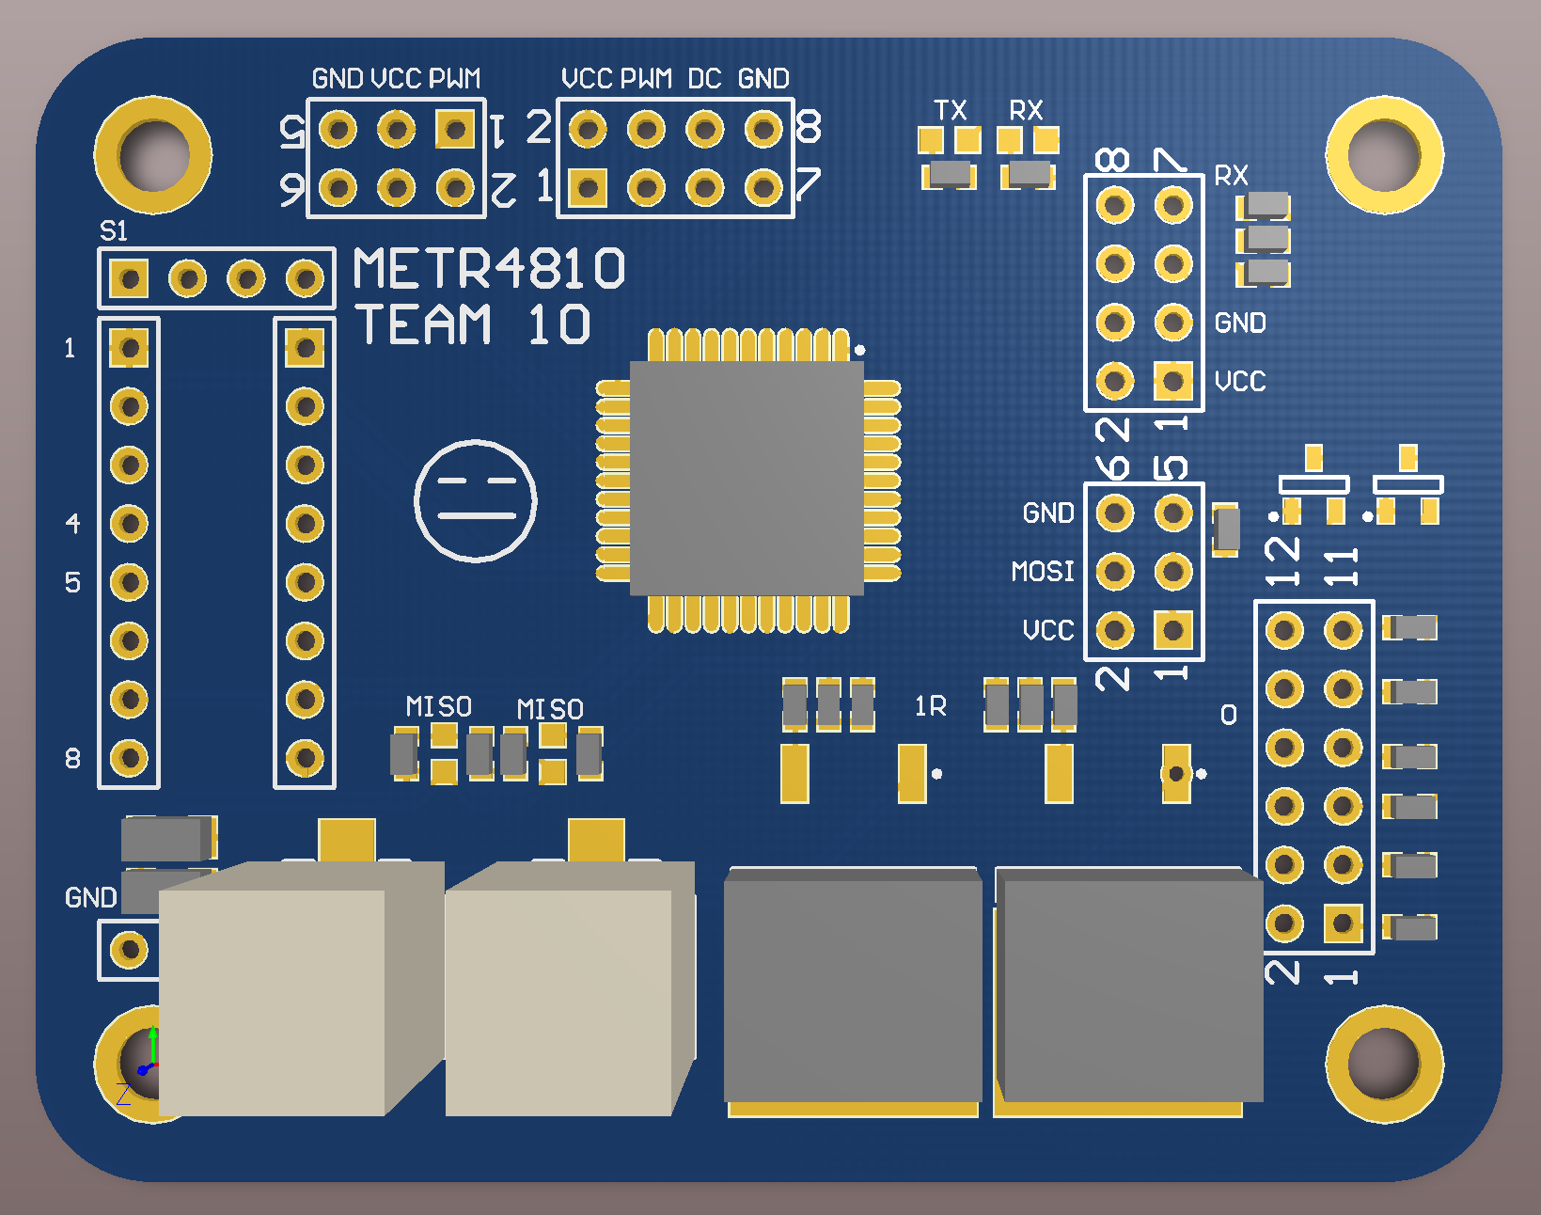
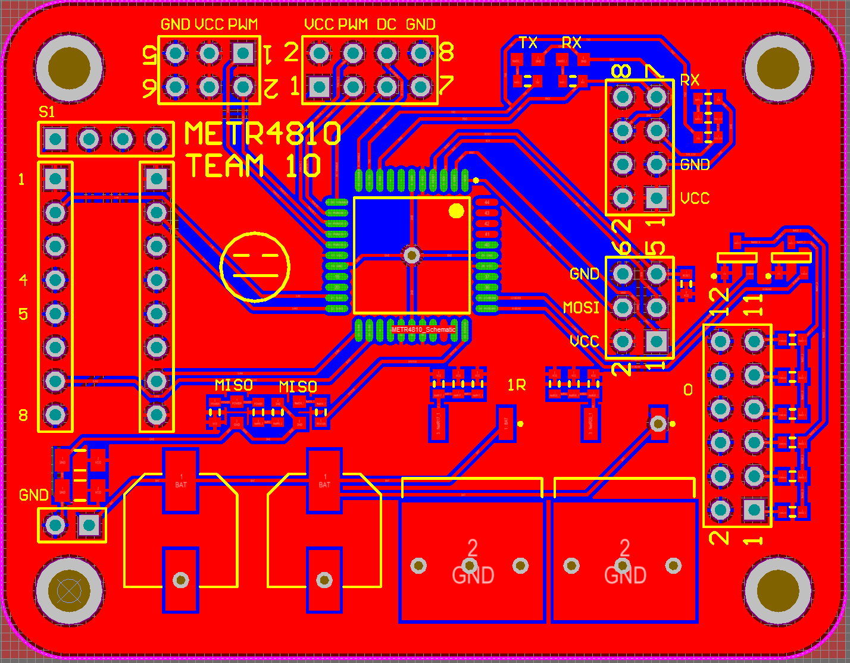
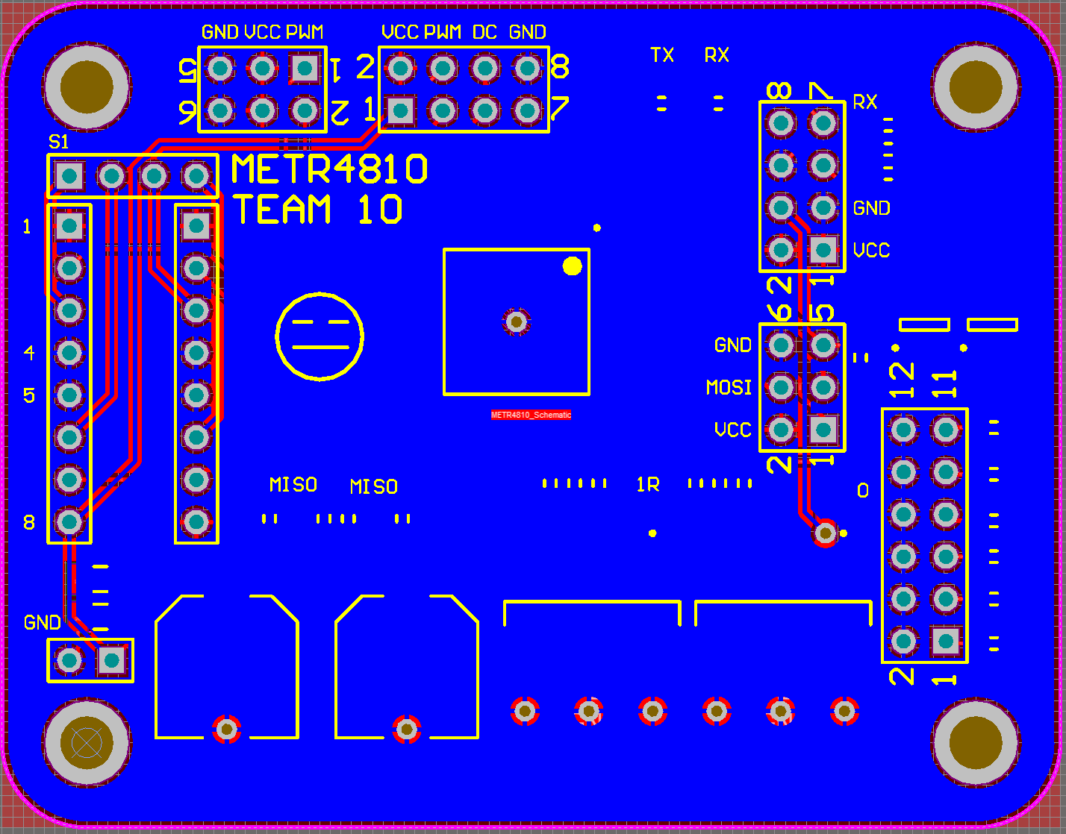
PCB

Slide 4
Comms
Bluetooth module, still design choice
Comms ported from the ATmega32m1 to the ATmega324
In tank testing to be completed

Slide 5
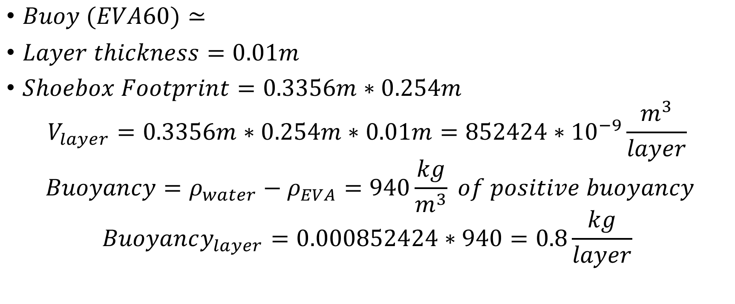
Buoy
$Buoy (EVA60)≃$
$Layer thickness=0.01m$
$Shoebox Footprint=0.3356m∗0.254m$
$$V_{layer}=0.3356m∗0.254m∗0.01m=852424∗{10}^{−9}\frac{m^{3}}{layer}$$
$$Buoyancy=ρ_{water}−ρ_{EVA}=940\frac{kg}{m^{3}} of positive buoyancy$$
$$Buoyancy_{layer}=0.000852424∗940=0.8\frac{kg}{layer}$$

Slide 6
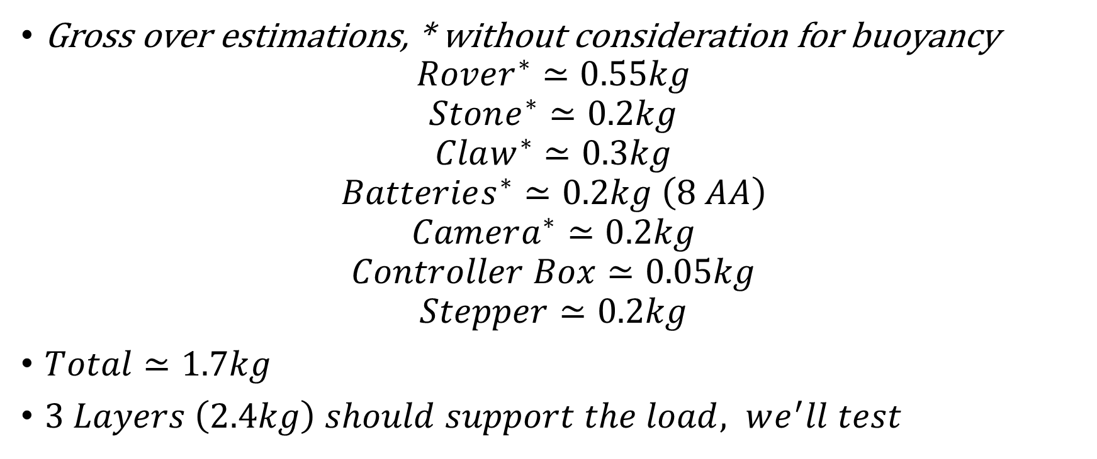
Buoy
Gross over estimations, * without consideration for buoyancy
$$Rover^{∗}≃0.55kg$$
$$Stone^{∗}≃0.2kg$$
$$Claw^{∗}≃0.3kg$$
$$Batteries^{∗}≃0.2kg \left(8 AA\right)$$
$$Camera^{∗}≃0.2kg$$
$$Controller Box≃0.05kg$$
$$Stepper≃0.2kg$$
$Total≃1.7kg$
$3 Layers \left(2.4kg\right) should support the load, we^{′}ll test$

Slide 7
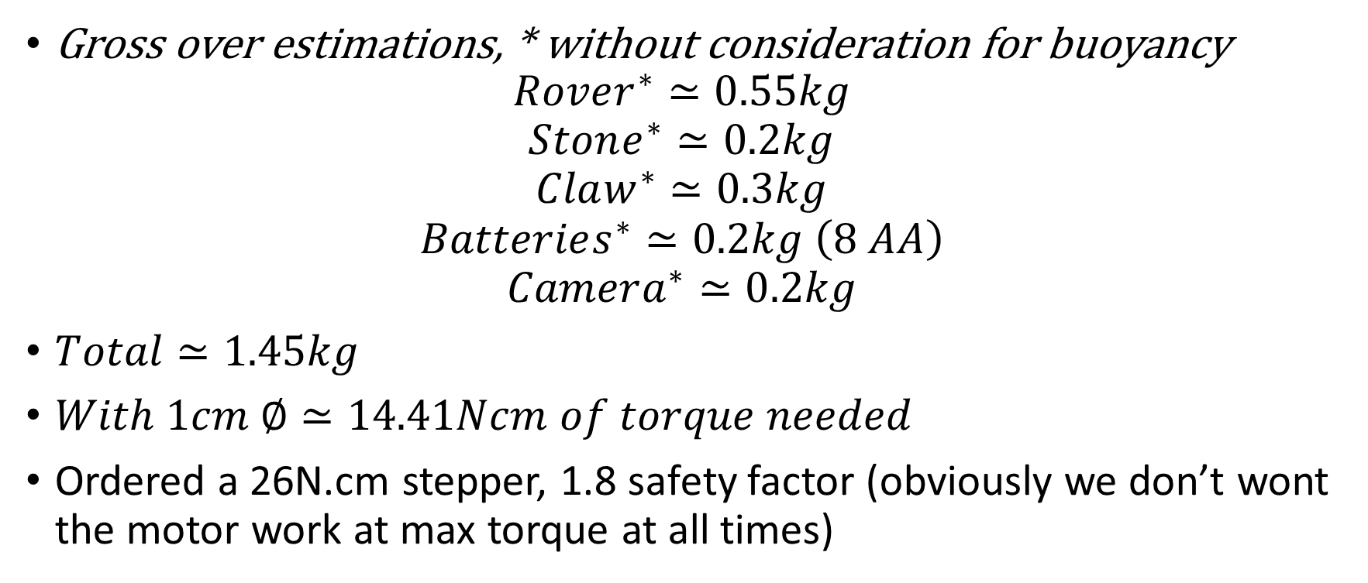
Stepper
Gross over estimations, * without consideration for buoyancy
$$Rover^{∗}≃0.55kg$$
$$Stone^{∗}≃0.2kg$$
$$Claw^{∗}≃0.3kg$$
$$Batteries^{∗}≃0.2kg \left(8 AA\right)$$
$$Camera^{∗}≃0.2kg$$
$Total≃1.45kg$
$With 1cm ∅≃14.41Ncm of torque needed$
Ordered a 26N.cm stepper, 1.8 safety factor (obviously we don’t wont the motor work at max torque at all times)

